Slide 1

Intro to PERFORM’s
Cluster
April 2021
By: Thomas Beaudry

Slide 2
A very very brief intro to linux commands
Directory listing: username@perf-hpc01:~$ ls
Change directory: username@perf-hpc01:~$ cd example
Write text to a new/old file: username@perf-hpc01:~$ echo "some text" >> file1.txt
Rename file: username@perf-hpc01:~$ mv file1.txt newFile.txt
Make directory (folder): username@perf-hpc01:~$ mkdir subdir
Copy file: username@perf-hpc01:~$ cp newFilename.txt subdir/
Change directory: username@perf-hpc01:~$ cd subdir
Read file: username@perf-hpc01:~$ cat newFile.txt
Search file for word: username@perf-hpc01:~$ cat newFile.txt | grep "text"
Delete file: username@perf-hpc01:~$ rm newFile.txt
What folder am I in?: username@perf-hpc01:~$ pwd

Slide 3
What is a cluster?
What machines are connected to our cluster?
What is a compute node?
What is a workstation?
A series of connected machines
12 compute nodes. 23 researcher workstations
A powerful server used to process data that is in a server room that doesn’t have a monitor (perf-hpc01 through perf-hpc12)
A powerful desktop computer owned by a PI (Primary Investigator – a faculty researcher)

Slide 4
What is a data center?
What is a domain computer?
What is storage?
Local vs Remote storage?
A very cold air-conditioned locked room where all our servers are located (Concordia has two, one each at SGW and Loyola campus)
A machine that is joined to Concordia's domain.
Signs that it’s joined: If you can login with your Netname, If the output from “realm list” is concordia.ca
* If you are joined you don’t need to type .concordia.ca when connecting to a box
Where data is stored (hard drives)
Local: On the hard drive that you are using
Remote: Our file server

Slide 5

File Server
Over 100 TB of storage
Access is only through Netname accounts
What’s on it? /NAS, home folders, modules, project & PI folders
Servers, workstations, imaging archiving servers
Not fully in our control
Slower than a local hard (especially MATLAB!)
We have a backup one downtown

Slide 6
File Server Data organization
What’s in a Project folder?
Home: /NAS/home Project: /NAS/Projects PI: /NAS/PI
username@perf-hpc01:/NAS/Projects/10000001$ ls
Data Documentation Notes Protocols
Imaging data:
/NAS/Projects/<projectNum>/Data/DICOM/PET
/NAS/Projects/<projectNum>/Data/DICOM/MRI
/NAS/Projects/<projectNum>/Data/MRS/ (data is in there, and OpenMRS output in outputs)
Home: /NAS/home Project: /NAS/Projects PI: /NAS/PI

Slide 7
User Accounts
Local Account vs Network account
Local: An account that exists only on your machine
Pro: If the file server is unresponsive you can still use your computer
Con: running jobs on the cluster requires lots of manual setup, only exists on 1 machine, separate home folders
Network: A Netname account
Pro: connect to any machine, share your home folder across the machines
Con: user identity is managed by Concordia name server

Slide 8
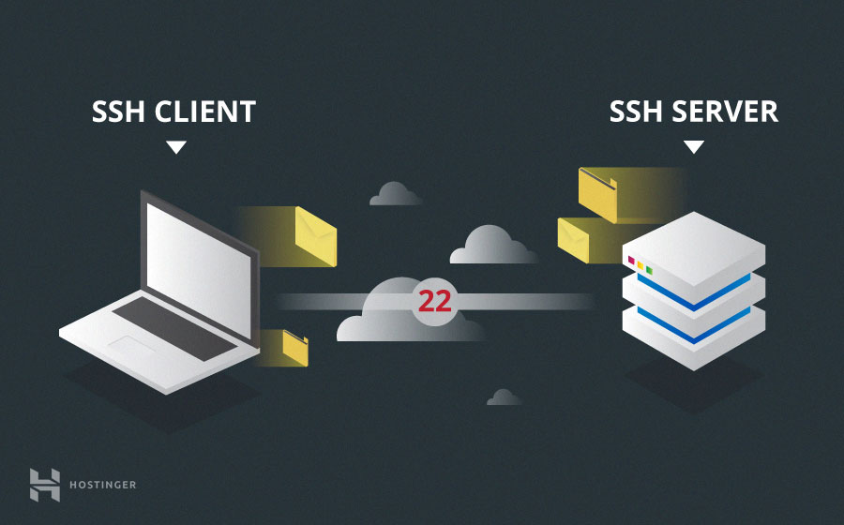
Connecting remotely to the cluster
From linux & OSX:
From windows:
ssh netname@perform-hpc
ssh -XY netname@perform-hpc (if you want to use graphical programs)
Type: goto_execution_node to be sent to a machine that’s load isn’t too heavy
* or setup x2go if you want a remote desktop experience (But specify a machine name i.e. perf-imglabXX)
Use mobaxterm (https://mobaxterm.mobatek.net/download.html) and use the same linux commands

Slide 9
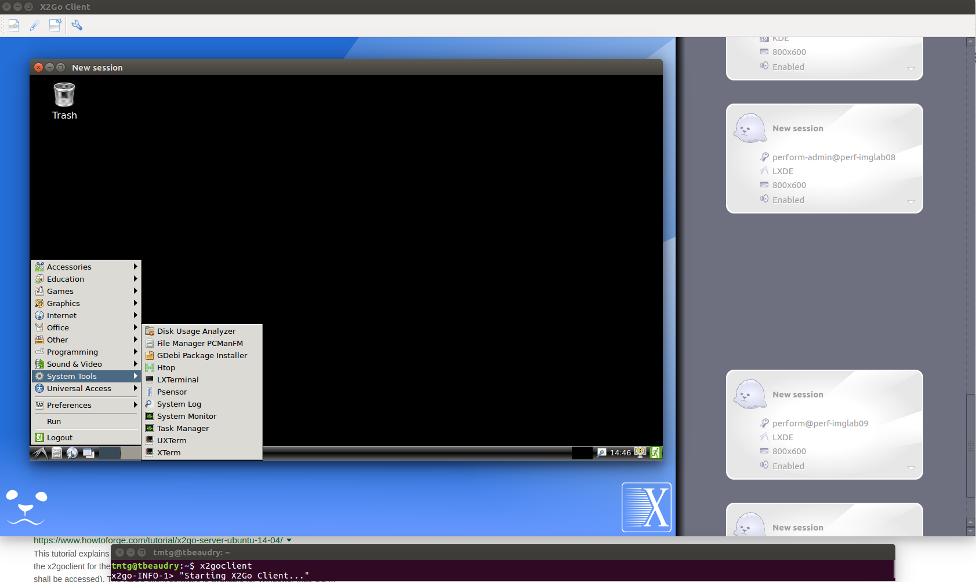
Connecting remotely to the Cluster - X2Go
X2Go is a remote
Desktop software
That can be used
Instead of ssh

Slide 10
Copying files
From your workstation
From a computer not joined to our domain to a node
From the server to your local computer?
Regular cp commands work since the file server is automatically mounted
Copy to a file from a path to your home folder on the server:
scp /filePath/myFile.txt yourNetname@perform-hpc:
Copy a file from the the directory you are in to a specific path on the server:
scp myFile.txt yourNetname@perform-hpc:/NAS/Projects/9000080/
If you are copying a directory you need “scp -r”
scp awesome.txt localUser@computerName_or_IP_address:
An alternative to scp would be to use a 3rd party graphical software like filezilla: https://filezilla-project.org/

Slide 11
Using the Cluster: Modules
To see which modules (software packages) are available:
module avail
To load a software / package:
module load <moduleName>/<version> (if no version is specified it will use the default)
To see which modules you have active:
module list
To unload a module:
module unload <module>
To unload all loaded modules:
module purge

Slide 12

Scheduler
What is it?
Which one do we use?
Anything else to know about it?
A service that takes job requests and finds an available machine to process it. Allowing for parallelization of jobs.
SGE (Son of Grid Engine)
PERFORM-HPC is the server that runs the scheduler. Hence, it can’t process data
scp awesome.txt localUser@computerName_or_IP_address:

Slide 13
Submitting jobs
From within a script:
#####example of a script resampleimage.sh
#!/bin/bash
qsub -j y -o logs/mnc_out.txt -V -cwd -q all.q -N mncresample <<END
mincresample /path/to/image/file.mnc -like /path/to/image/template.mnc out.mnc
END
Important:
-o logs/mnc_out.txt | is the output of the job. Make sure that the logs folder exists
-q all.q | is the queue that you are submitting the job to
-N mncresample | is the name displayed in the queue
Optional:
-pe smp <num_cores> reserves <num_cores> which is a number from 1-32
-l h_vmem=<num>G reserves <num> GB of RAM, i.e. -l h_vmem=12G reserves 12GB
From the comand line:
qsub -j y -o logs/mnc_out.txt -V -cwd -q all.q -N mncresample ./resampleimage2.sh

Slide 14
Monitoring jobs
perform-admin@perf-hpc01:~$ qstat -f
queuename qtype resv/used/tot. load_avg arch states
---------------------------------------------------------------------------------
all.q@perf-hpc02.concordia.ca BIP 0/0/32 0.21 lx-amd64 ---------------------------------------------------------------------------------
all.q@perf-hpc03.concordia.ca BIP 0/0/32 0.07 lx-amd64
#################################################################
PENDING JOBS - PENDING JOBS - PENDING JOBS - PENDING JOBS
#################################################################
13269 0.55500 mnc_hpc03 perform-admi qw 04/11/2019 11:57:38 1
13279 0.55500 mnc_imglab perform-admi qw 04/11/2019 11:57:38 1
13280 0.55500 mnc_imglab perform-admi qw 04/11/2019 11:57:38 1

Slide 15
Useful Commands
Delete: qdel -j <job number>
Delete all your jobs: qdel -u <username>
Check job status (used for errors): qstat -j <job_number>
Summary of how busy the cluster is: qstat -g c
CLUSTER QUEUE CQLOAD USED RES AVAIL TOTAL aoACDS cdsuE ------------------------------------------------
all.q 0.02 0 0 352 466 0 114
matlab.q 0.02 0 0 192 192 0 0
See everyone’s job activity: qstat -f -u \*

Slide 16
Example of dealing with errors:
$qstat -f
################################################################## - PENDING JOBS - PENDING JOBS - PENDING JOBS - PENDING JOBS - PENDING JOBS
##################################################################
13382 0.55500 mnc_hpc01 perform-admi Eqw 04/12/2019 12:11:56 1
$qstat -j 13382
error reason 1: 04/12/2019 12:12:08 [1661213601:5373]: error: can't open output file "/NAS/home/perform-admin/logs/mnc_out.txt": No such file or directory

Slide 17
Submitting to specific hosts
The following script is a good example at how you can specify specific hosts to submit to.
#!/bin/bash
#perf-hpc01 through 12
for num in {1..12}
do
if [ ${num} -lt 10 ] #make sure num is 2 digits
then
num=0${num}
fi
queue=all.q@perf-hpc${num}
qsub -j y -o logs/mnc_out.txt -V -cwd -q $queue -N mnc_hpc${num} <<END
mincresample /util/packages/minc-toolkit/1.9.11/minc-itk4/icbm_segmented_masked.mnc -like /util/packages/minc-toolkit/1.9.11/minc-itk4/icb$
echo $HOSTNAME
END
done

